Slide 1
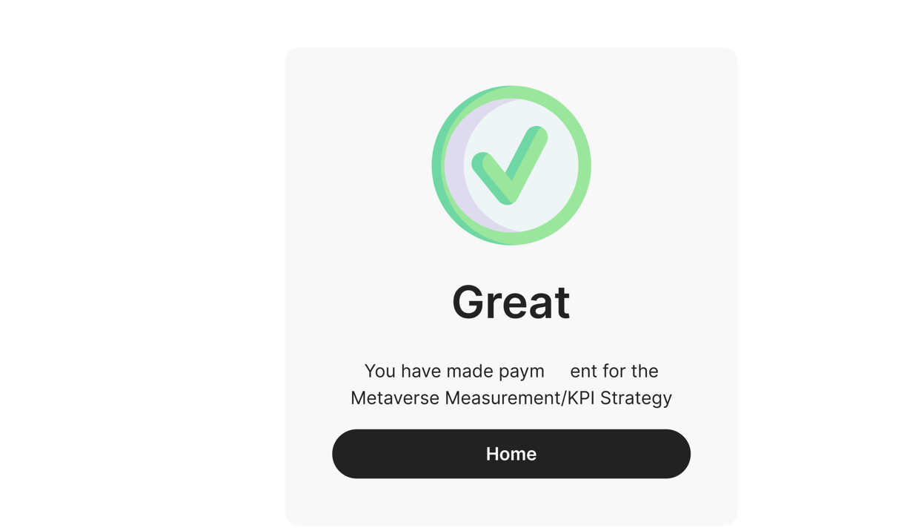
Thank you for choosing the Strategy & Vision category. This will give you a clear vision of the Metaverse, its opportunities, and how to build your own strategy quickly.
When user click on this button, he will be directed to the category he bought.
Enjoy now

Slide 3
Thank you for choosing the Solution category.
This will allow you to methodically apply your vision while thinking about the tools, technologies, and means necessary to achieve it.
Enjoy now

Slide 5
Thank you for choosing the Leadership category.
This part will give you a 360-degree vision to establish an information sharing culture and ecosystem within your organization.
Enjoy now

Slide 7




A post-purchase email is sent to user after purchase for the first-time user purchase. This is really important for a user. Here are all the things that has to be in the email reception.
Thanks for joining Muneland # Subject line
Hi {{Firstname}} 👋,
We are so excited to have you on board with Muneland! 🥳🥳🥳
WHY ?
The need for a sustainable and insightful asset that could guide the technological conversations became prevalent with a sudden spurt of interest in the metaverse. That’s why we’ve created Muneland.
Value
Muneland is a Platform to allow you to ask the essential questions and topics for establishing a strategy, and implementation of a solution around the Metaverse. The topics are laid out in the form of deliverables of activities to be followed by you (or by a team) and to help you achieve Leadership within your industry.
Be the first one who gets access to our new information that we may send you anytime.
Explore them!
Enjoy your moments on Muneland and don't hesitate to contact us if you have any question!
Muneland Team.
We think about how the world of tomorrow will connect!

